Slide 1

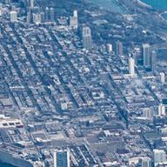




2022
Product Catalogue
Every day, we are striving to improve.
Every day, we challenge ourselves to be better – Get better.
Every day, we are producing results.

Slide 2



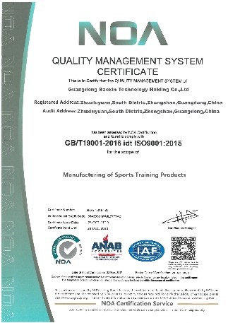
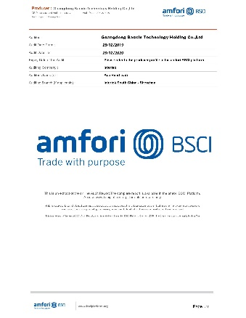
Who We are ?
We are a Sports Netting supplier with......
over 33,000 square meters. over 300 employees. over 500 specs of products. over $200 million turnover. over 10 years experience.
Why work with us ?
Because we will do our very best to provide you with outstanding service and high-quality Sport Nets on time and within your budget.
On Quality On Budget On Time
Zhongshan Fulmet Tech Co.,Ltd
Add.:Haicheng North Rd. Hengmen Industrial Zone Nanlang Town,
Zhongshan, Guangdong 528400
China
Tel:+86-15767593977
Contact: Karen Liu

Slide 3
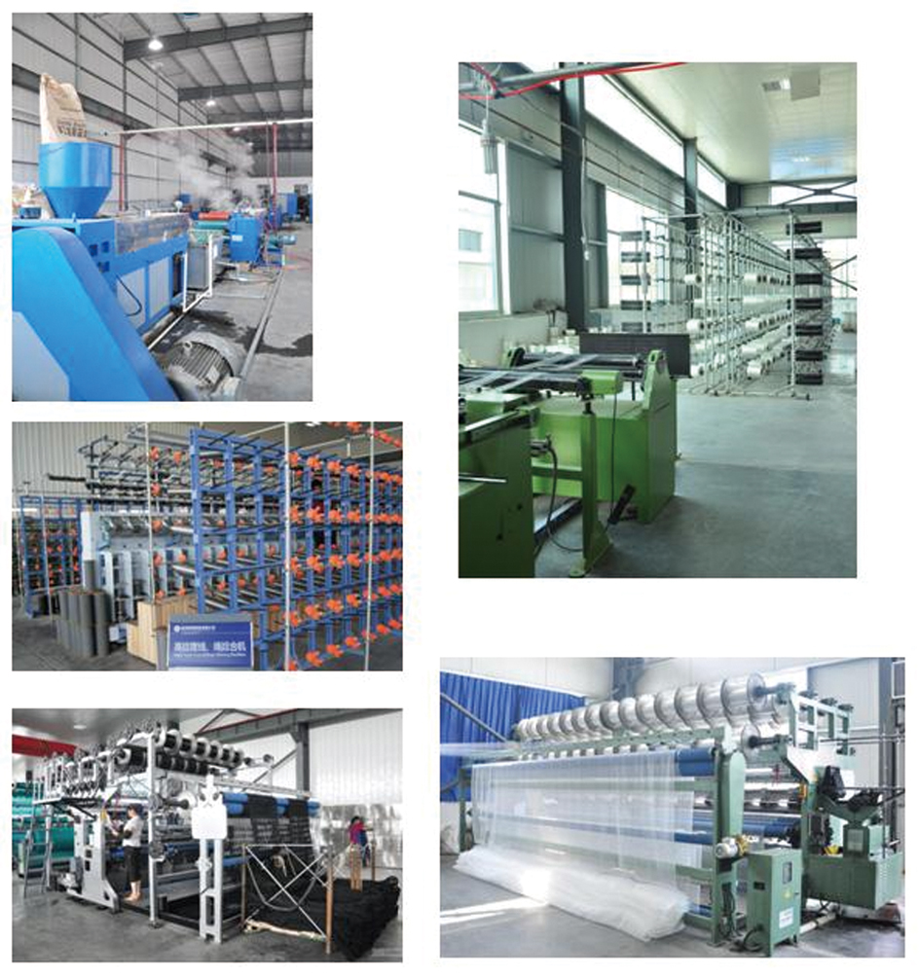
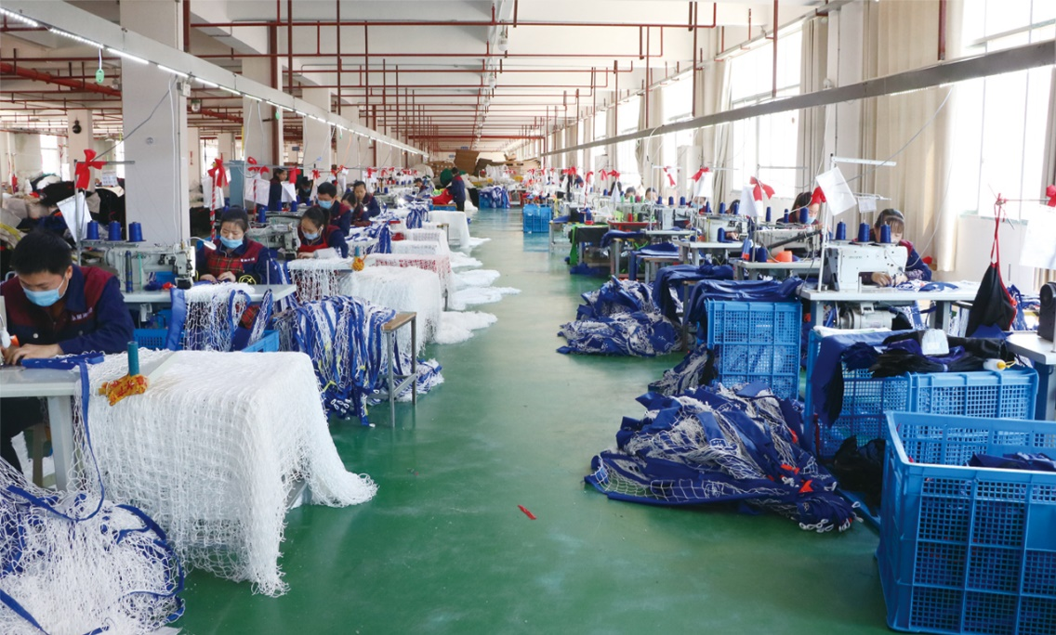
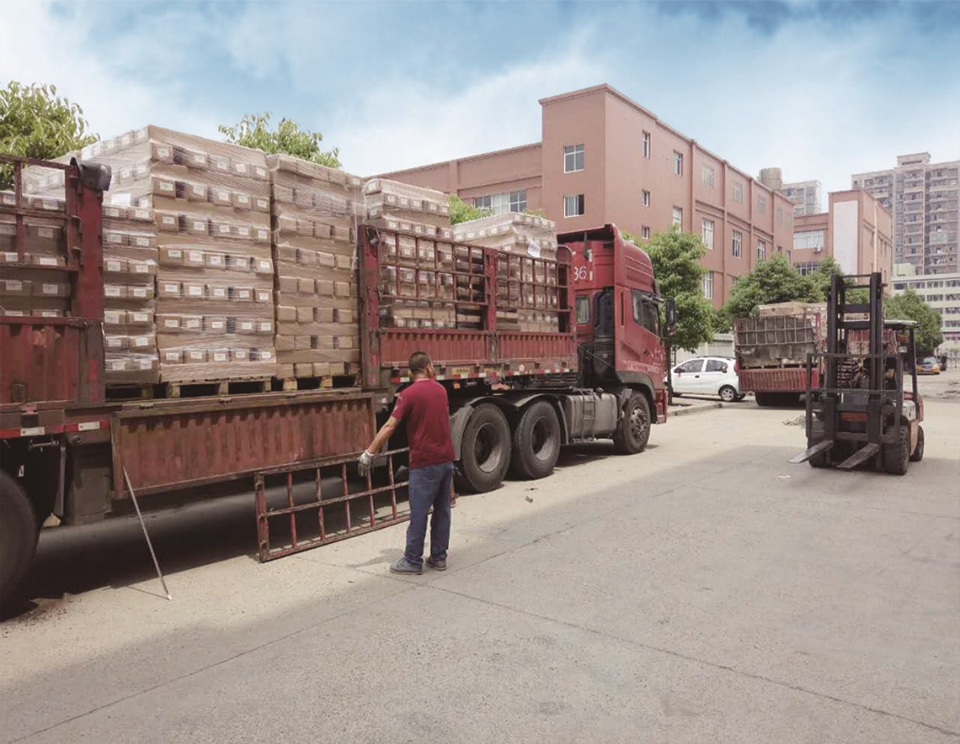
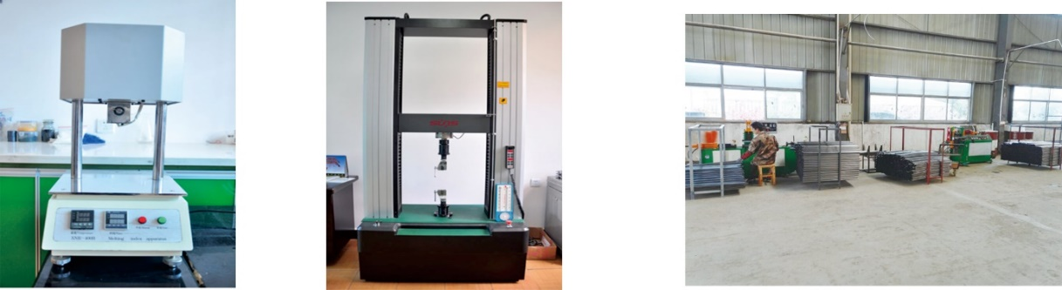
Workshop and Laboratory

Slide 4
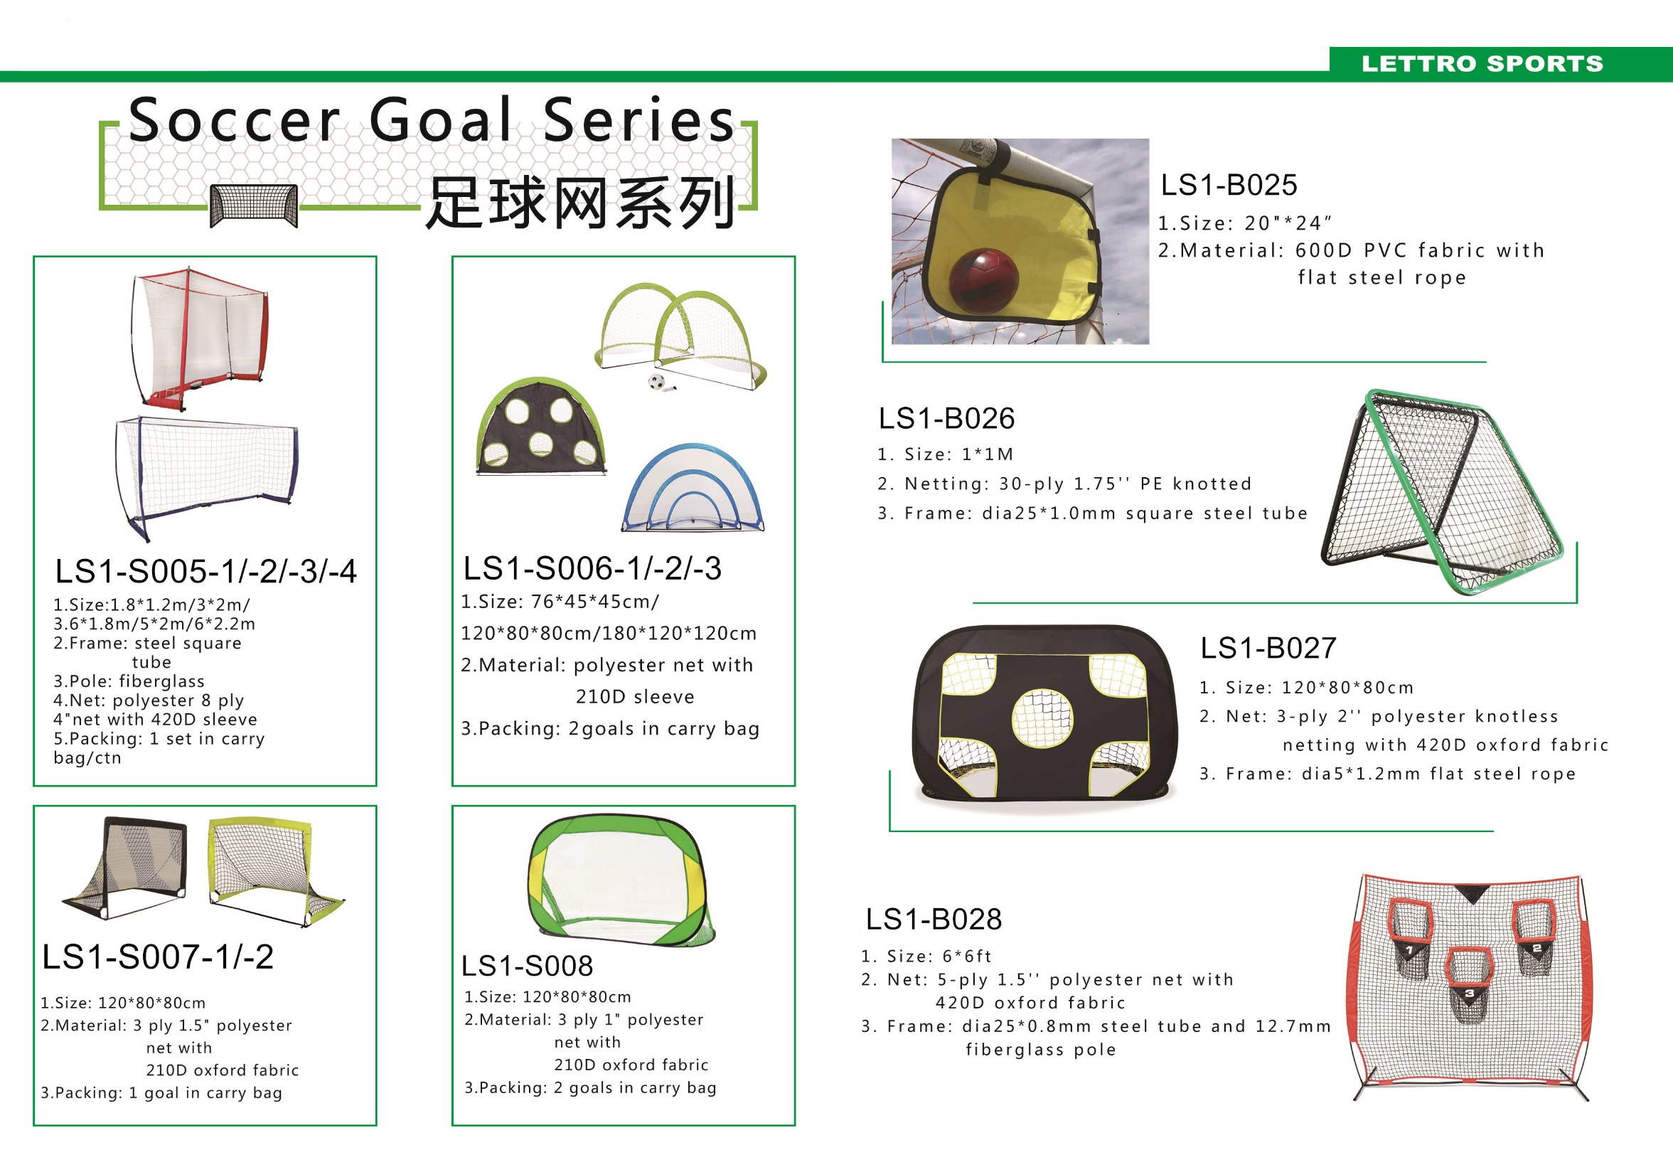

Slide 5
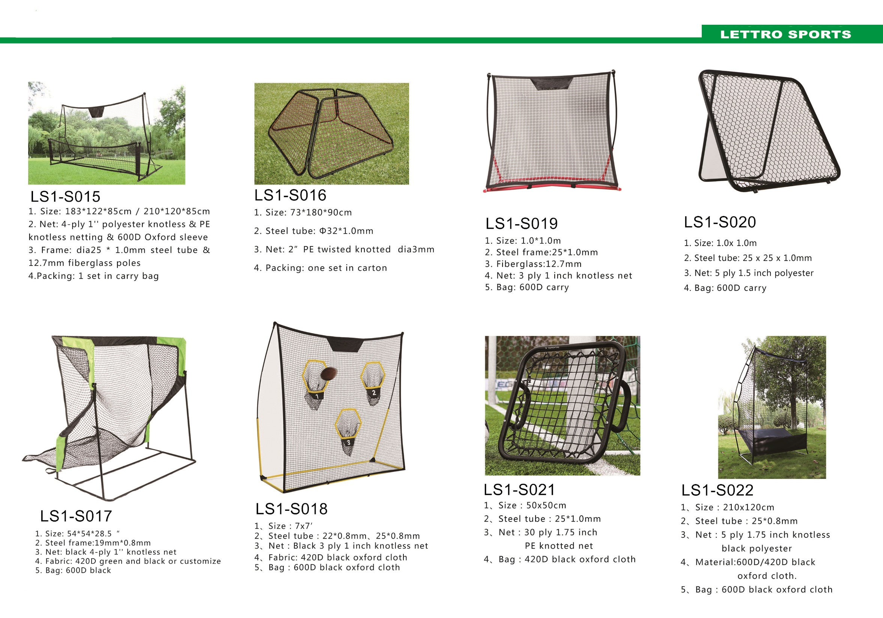

Slide 6
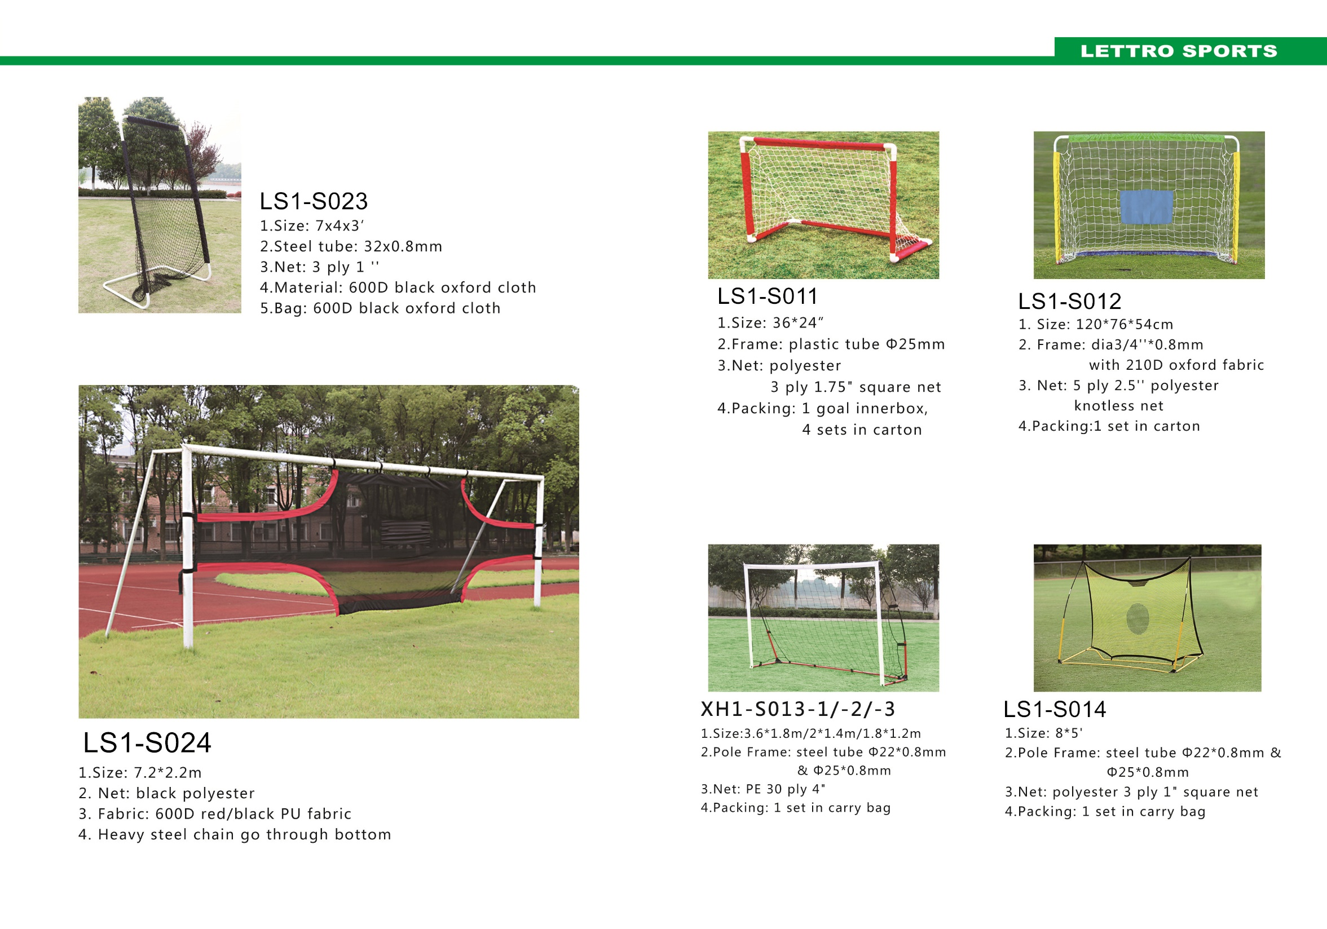

Slide 7
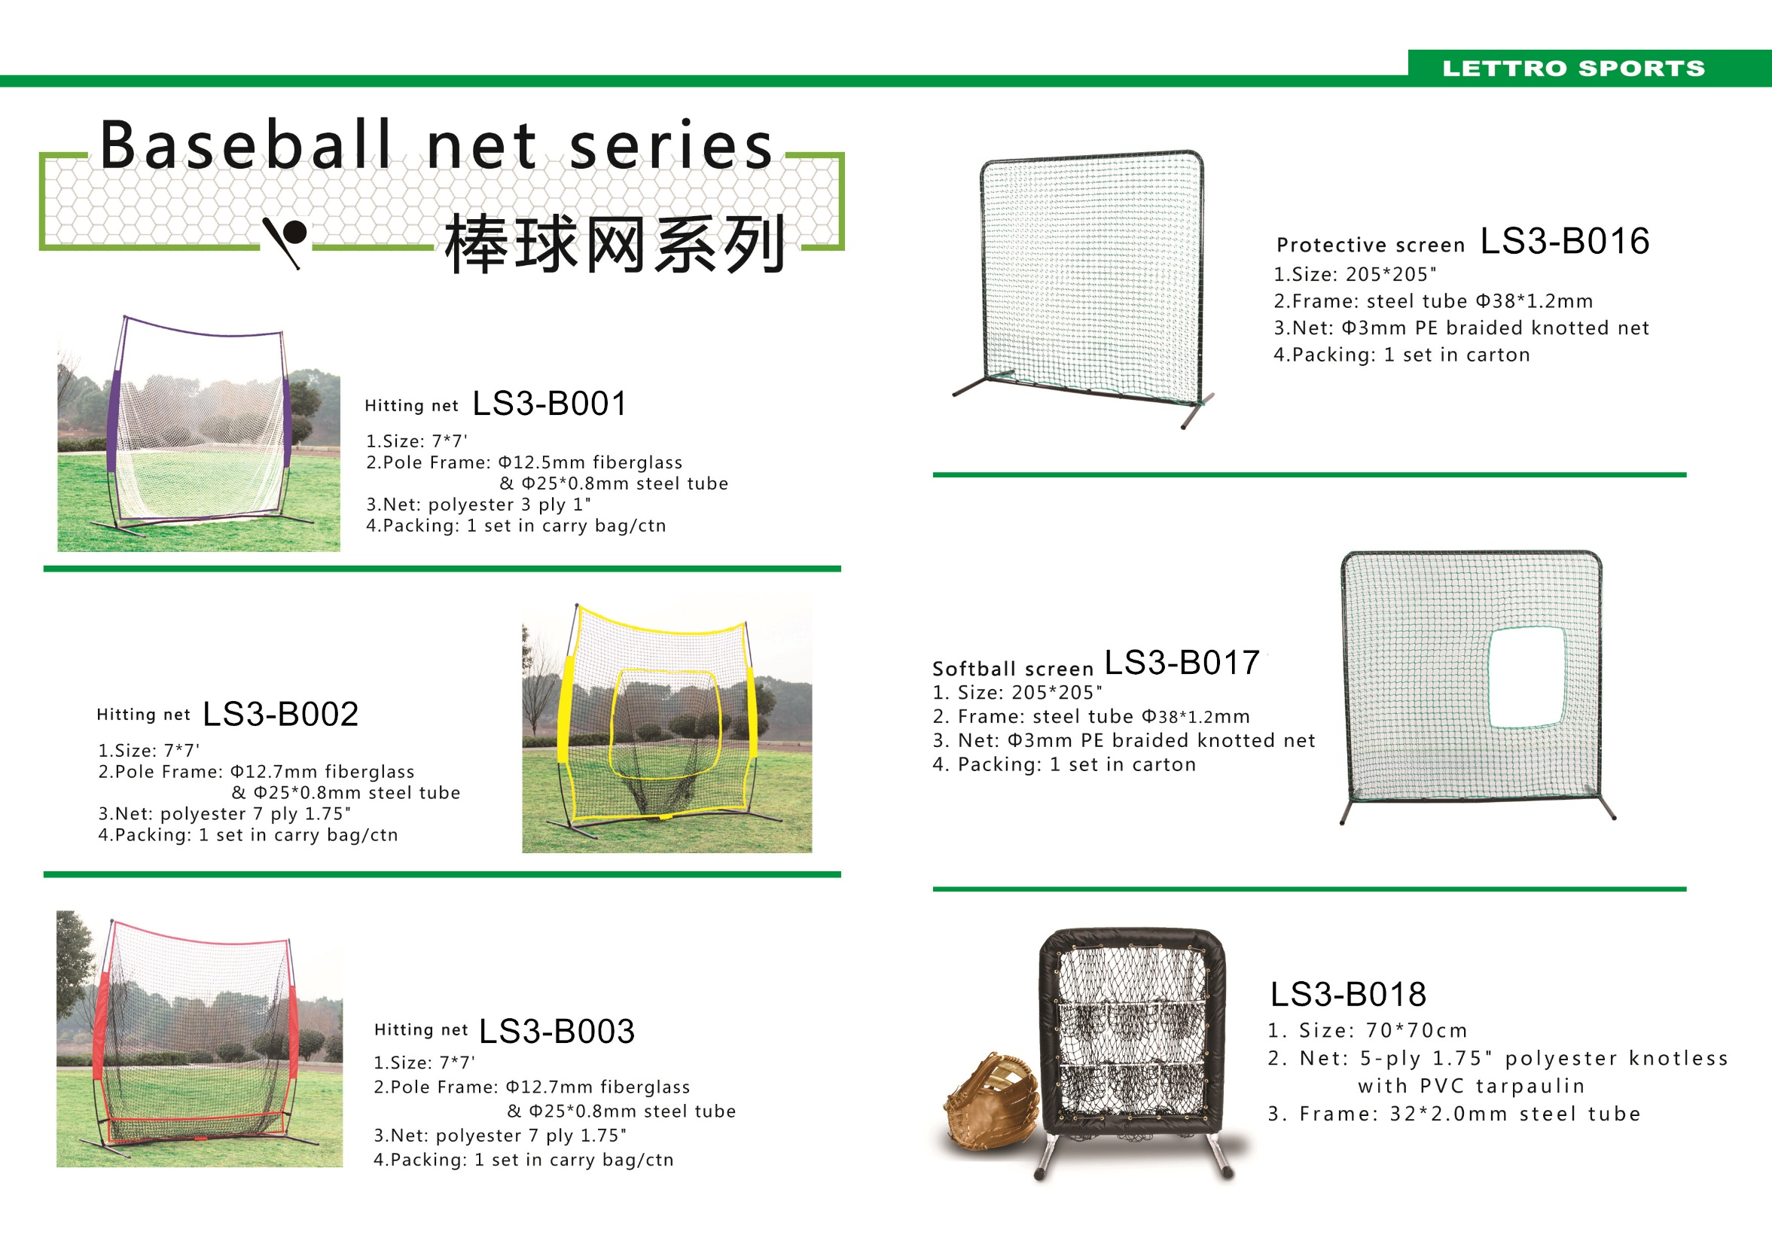

Slide 8
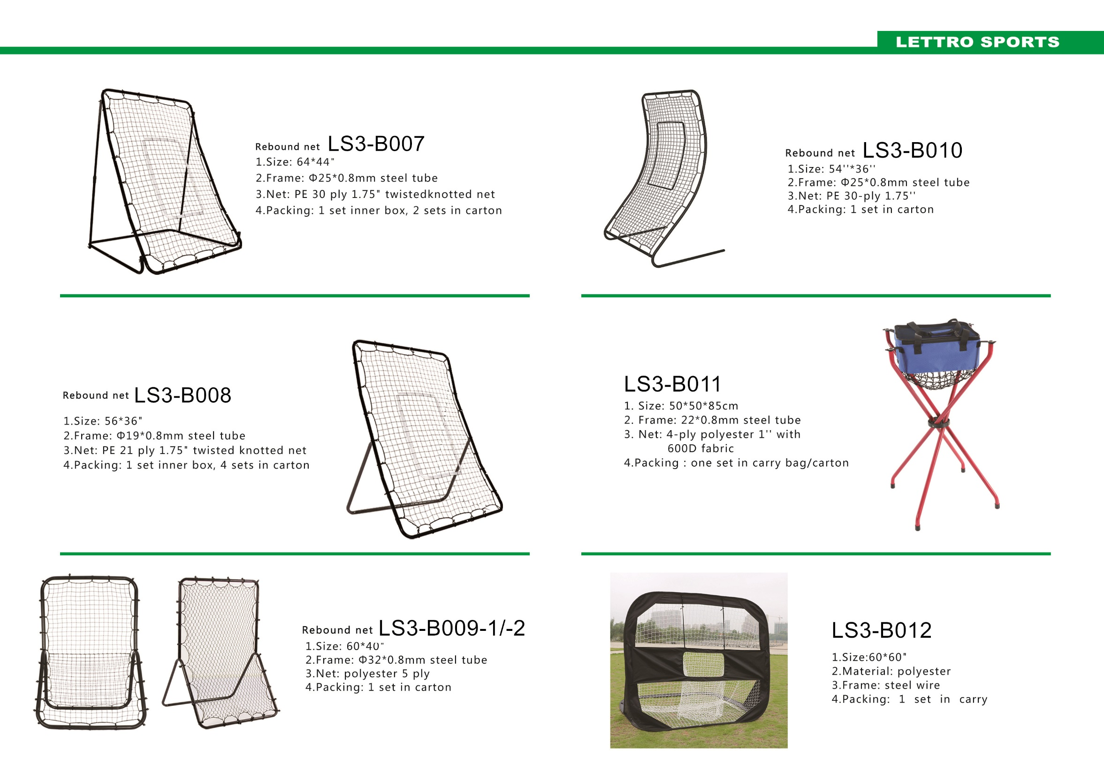

Slide 9
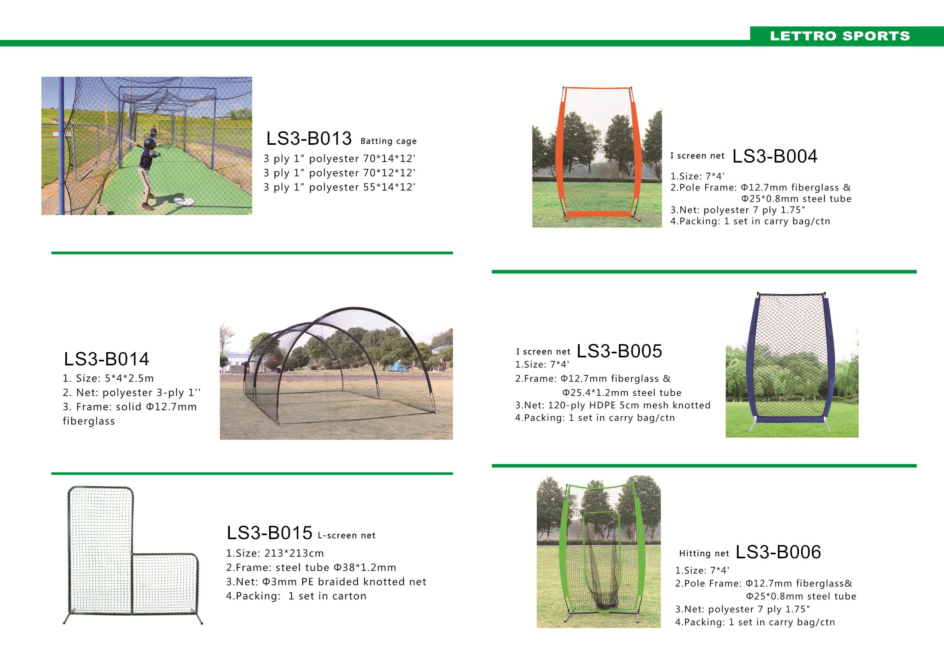

Slide 10
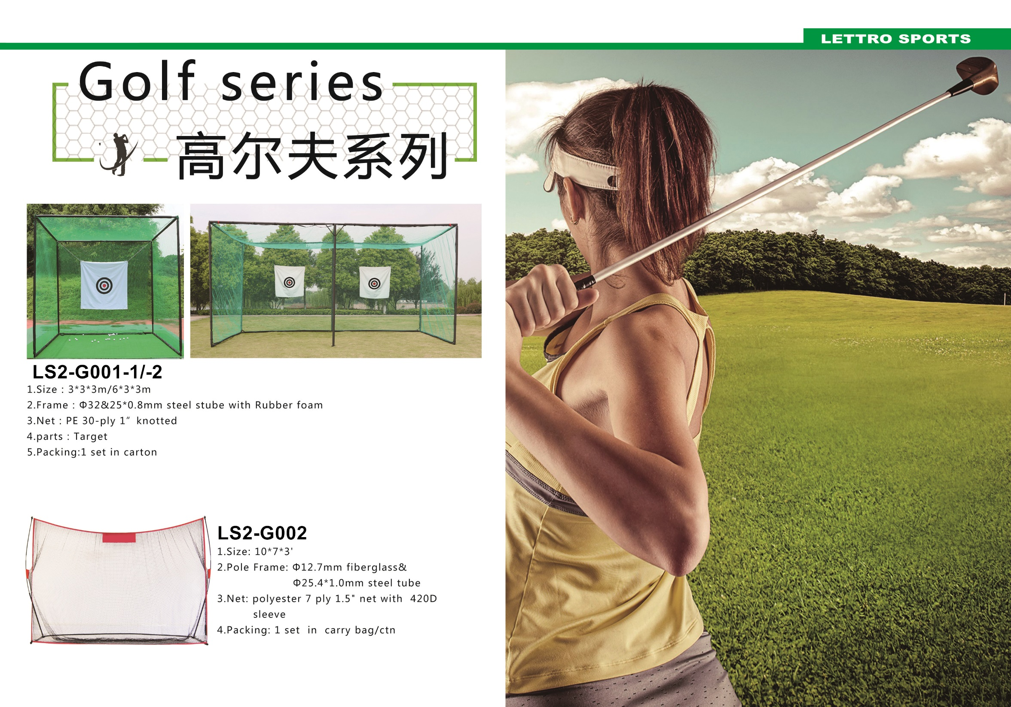

Slide 11
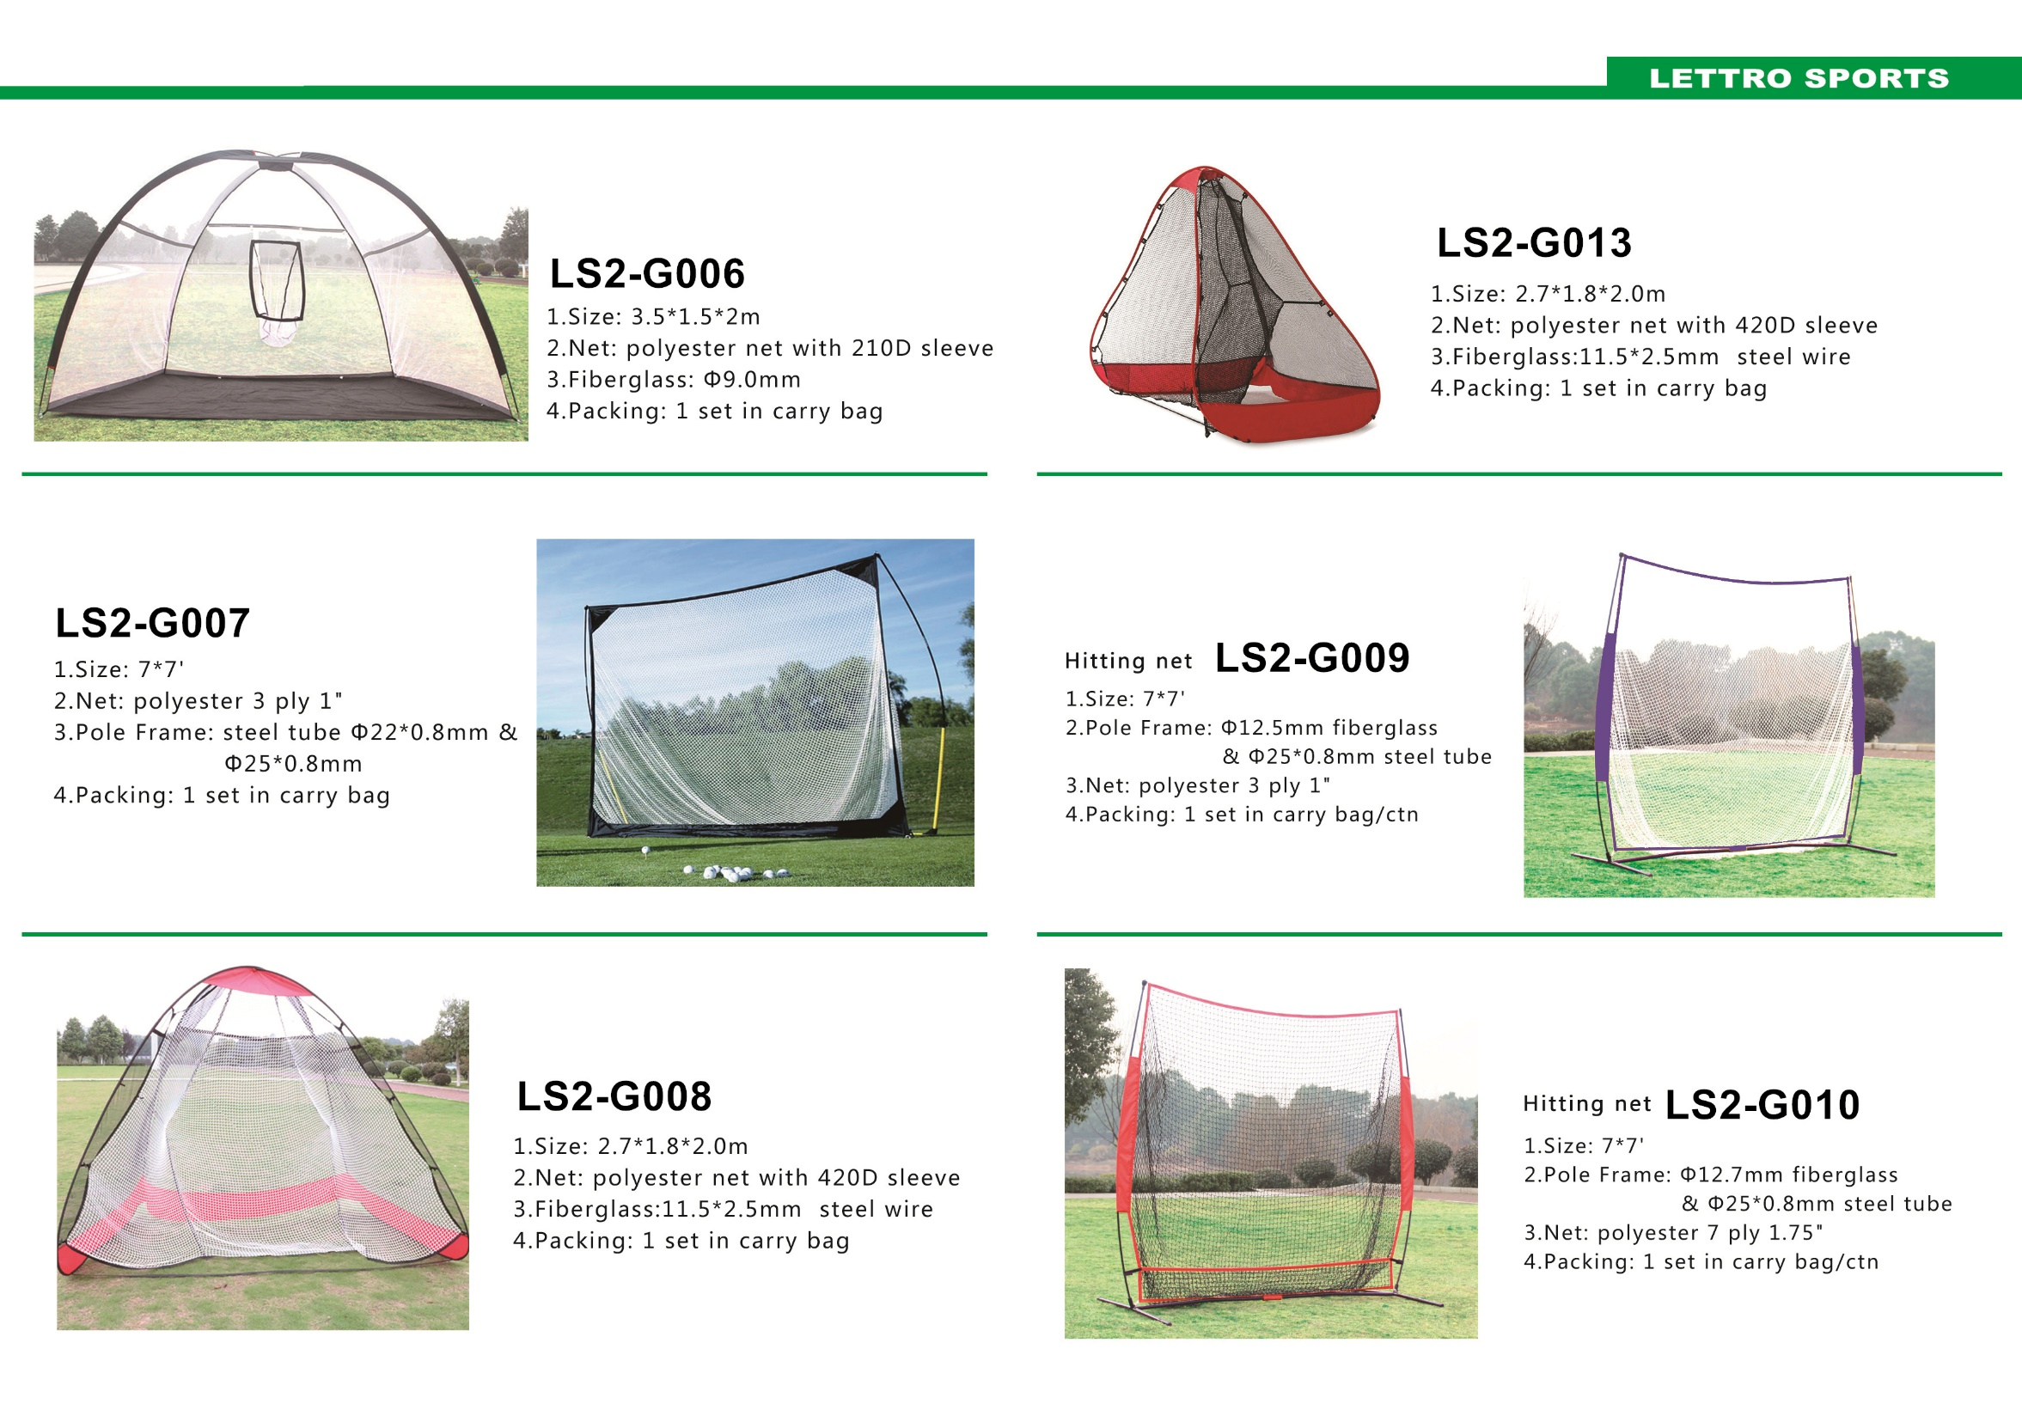

Slide 12
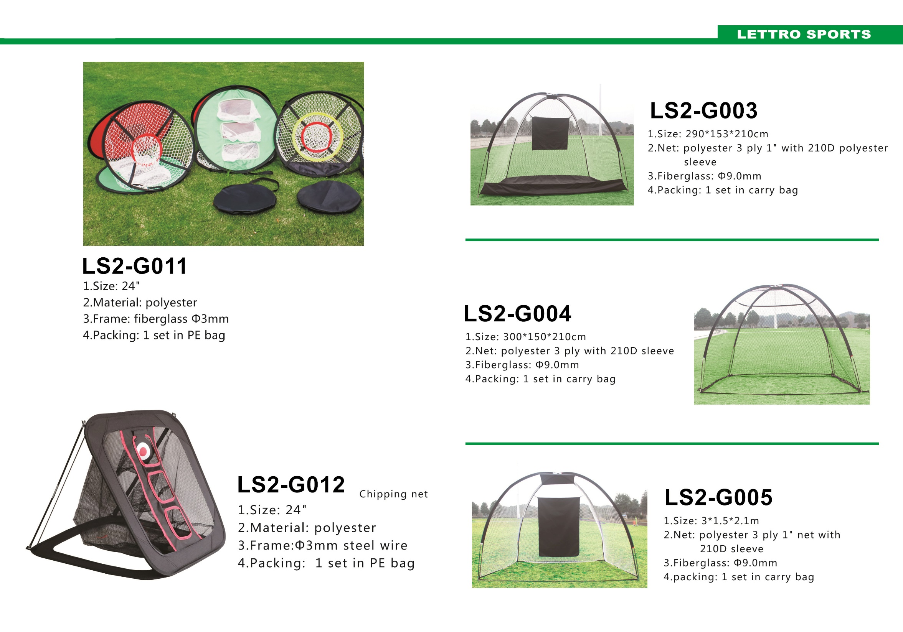

Slide 13
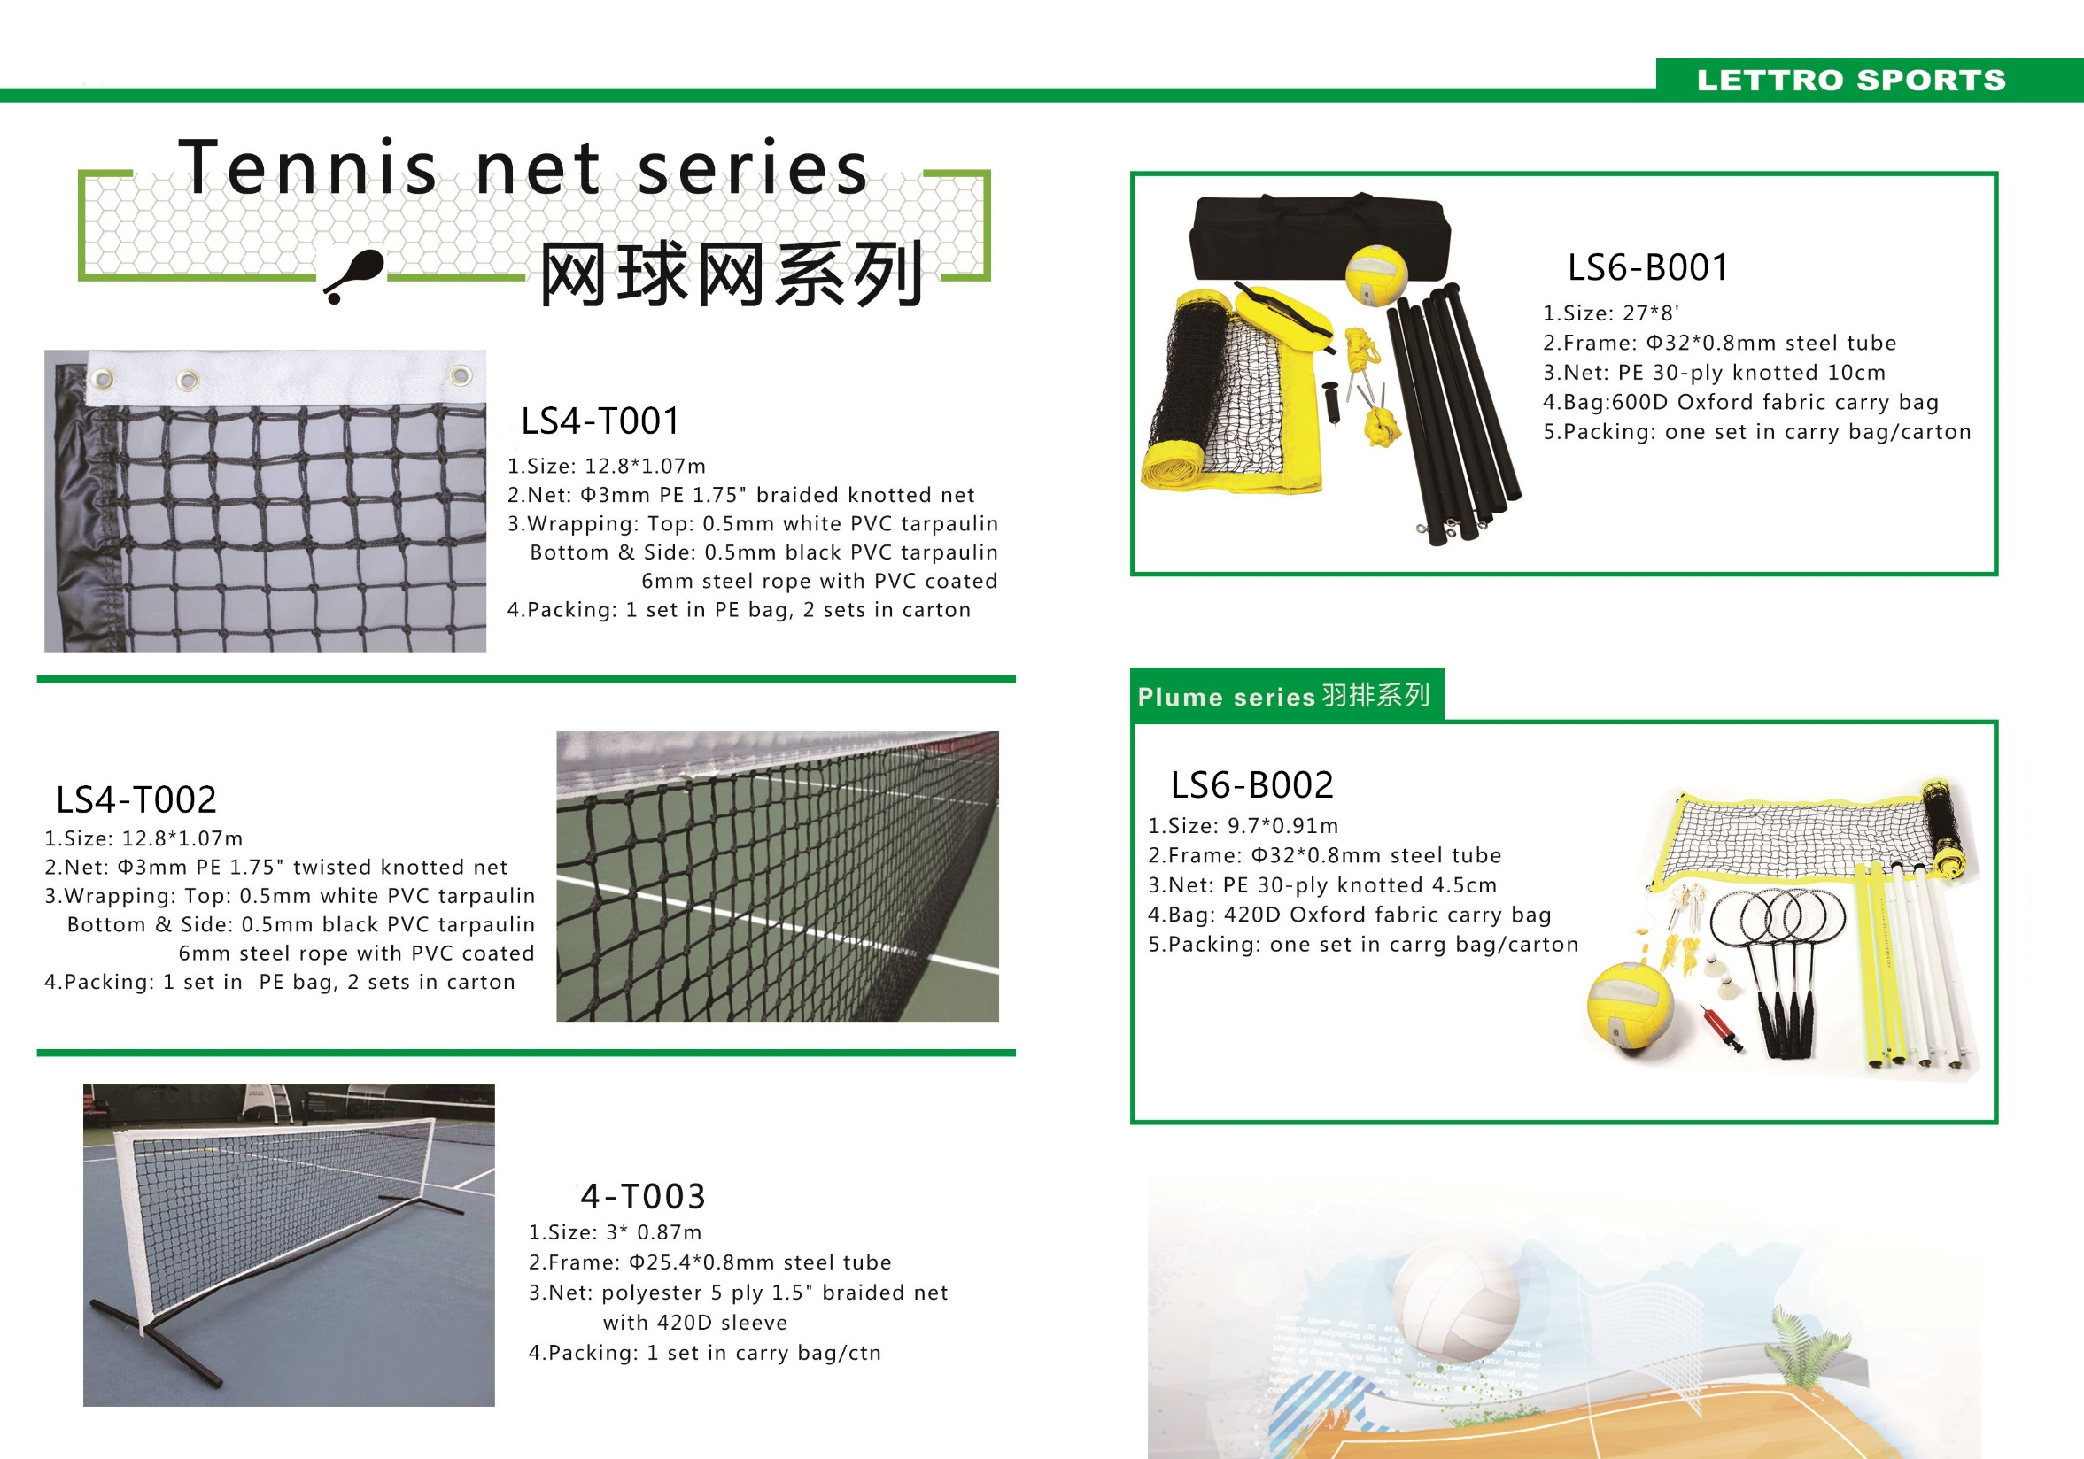

Slide 14
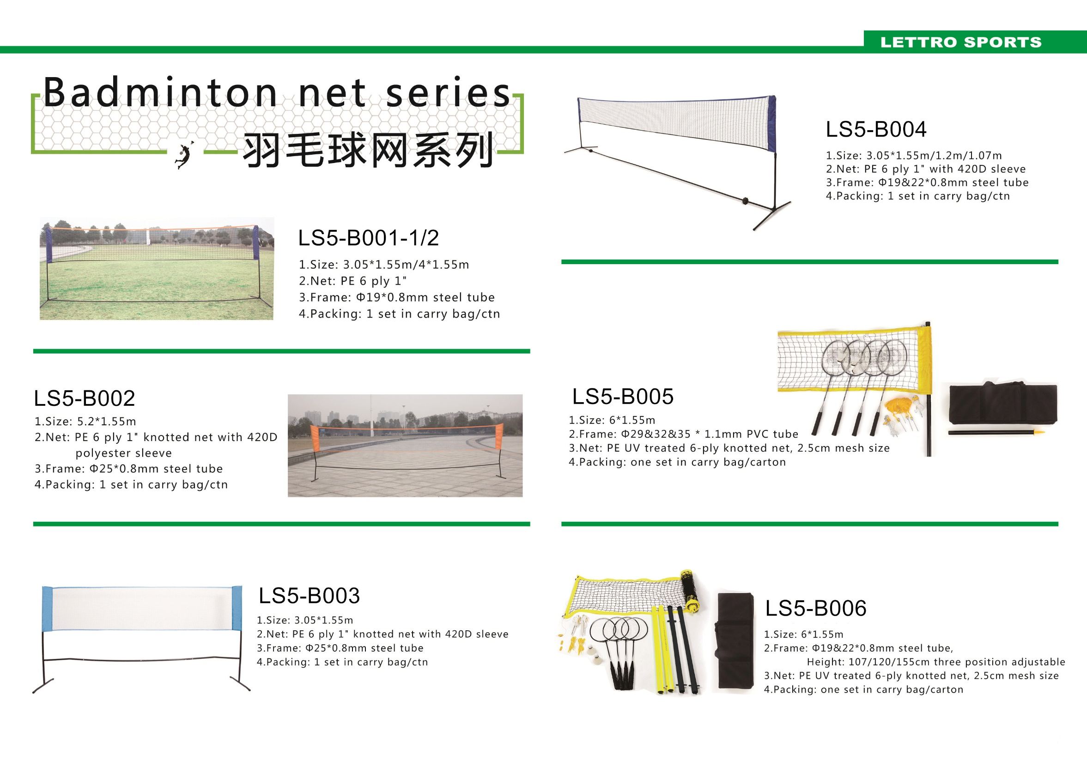

Slide 15
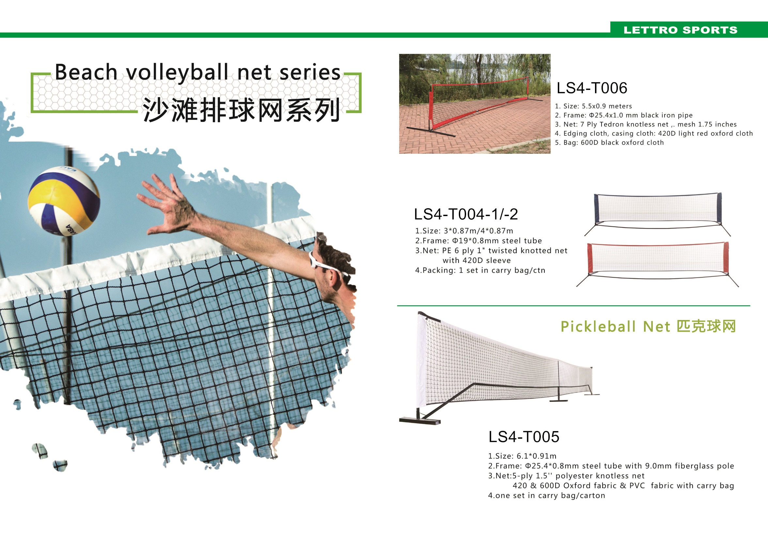

Slide 16
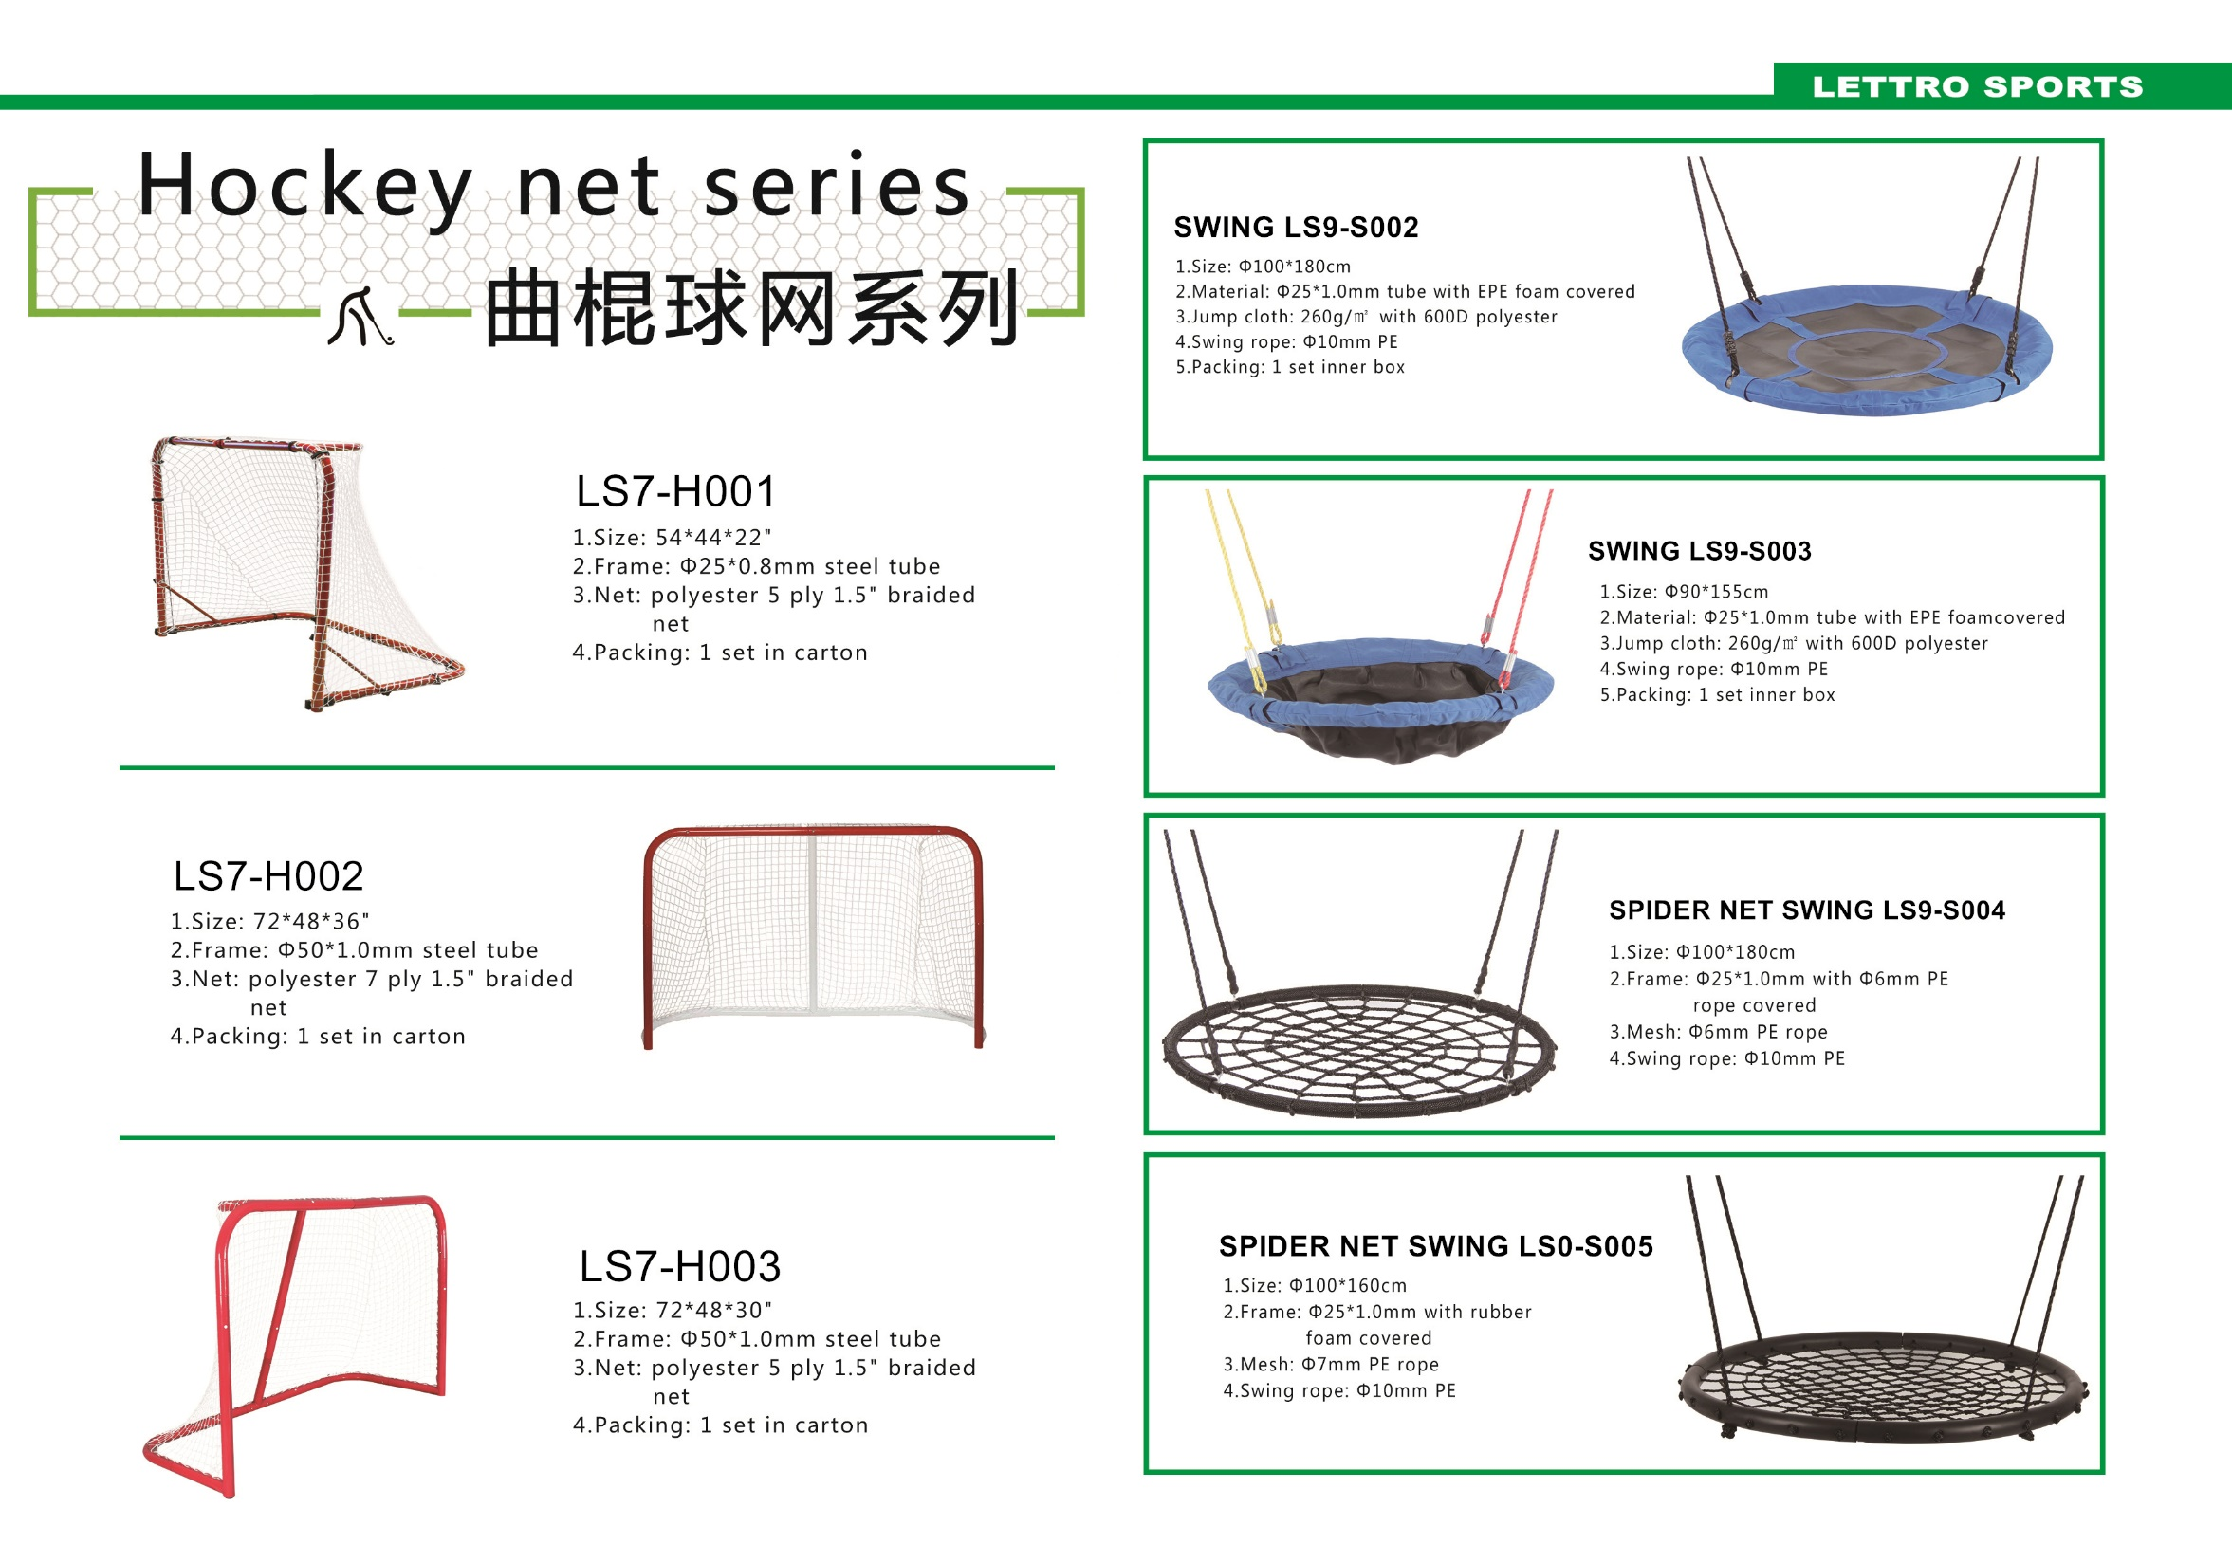

Slide 17
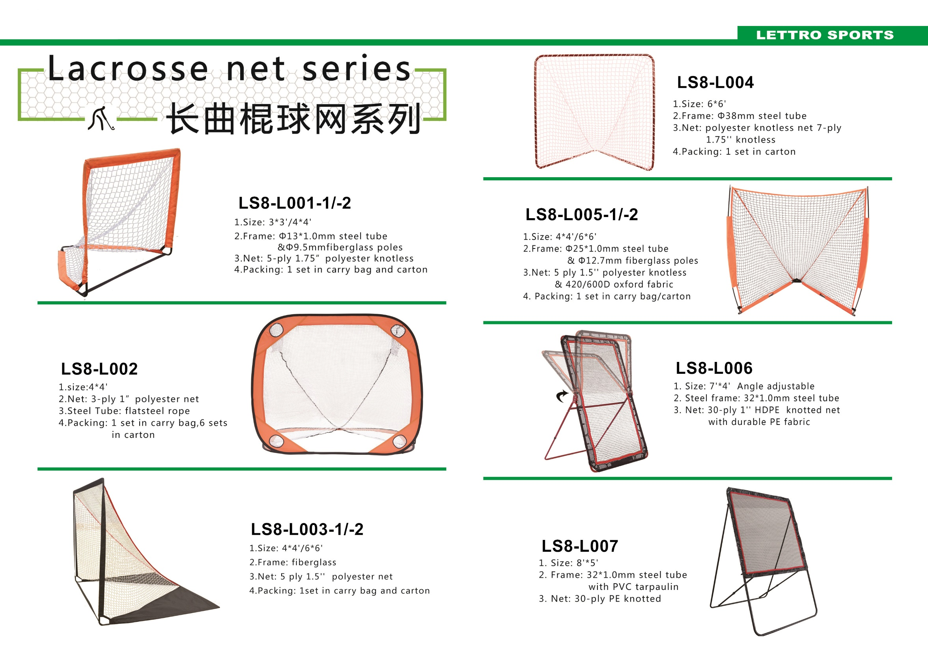

Slide 18
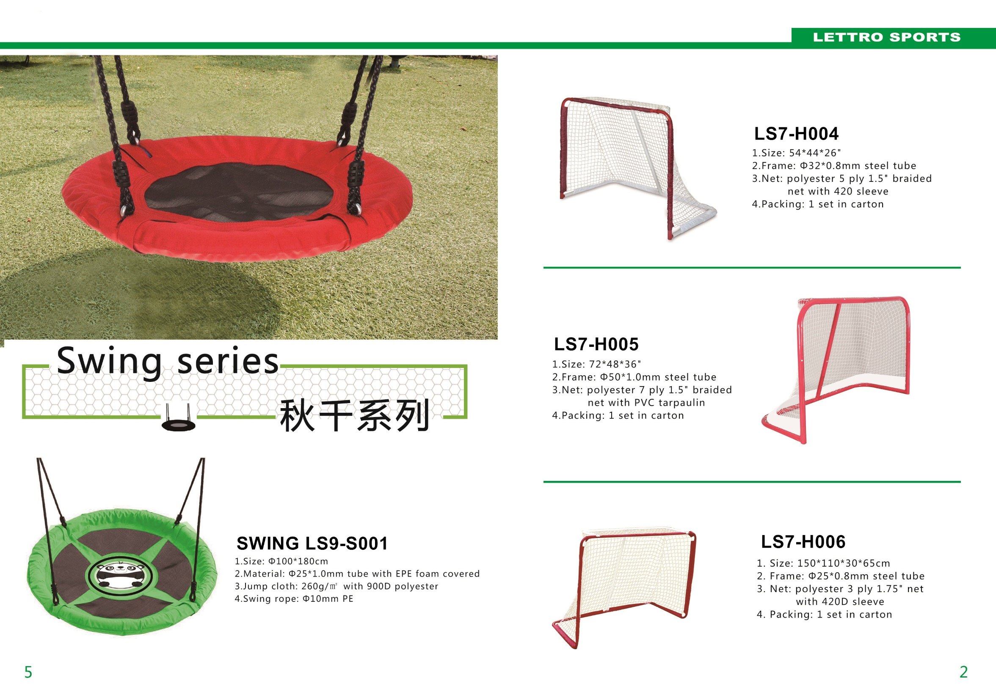

Slide 19

THANKS！
Zhongshan Fulmet Tech Co.,Ltd
Contact: Karen Liu
Karen@fulmetech.com
Tel:+86-15767593977
We Focus on Sport Netting Developing and Manufacturing

